Slide 1
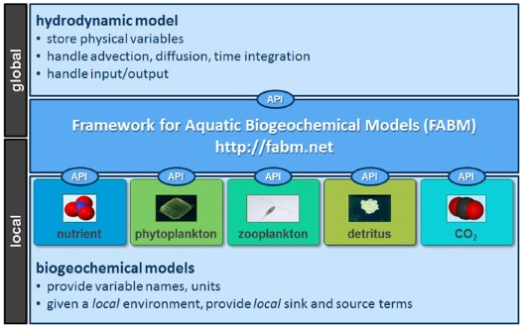
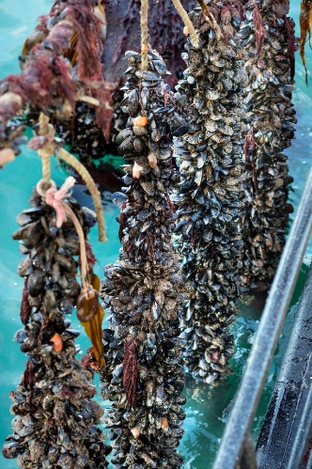
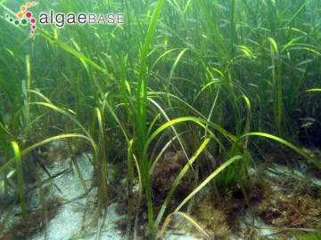
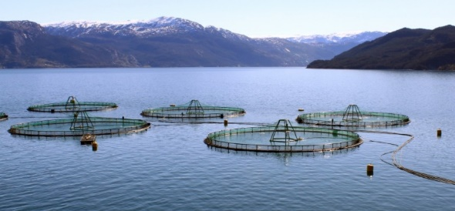
The Framework for Aquatic Biogeochemical Models
Jorn Bruggeman, Karsten Bolding

Slide 2
Aquatic modelling needs flexibility: challenges
questions
model ingredients
biogeochemistry
ecology
climate
carbon sequestration
deoxygenation
acidification
Plankton Functional Types
(variable) stoichiometry
C, N, P, Si, Fe
carbonate chemistry
bioremediation
eutrophication
oxygen, redox chemistry
coastal erosion prevention
macrophytes, seagrasses
structured populations
size vs. abundance
leisure, recreation
bathing water quality
jellyfish, harmful algae
charismatic species
benthic fauna
pelagic & benthic life stages
food provision
fisheries
aquaculture
fish & fisheries
IBMs
mammals & birds

Slide 3
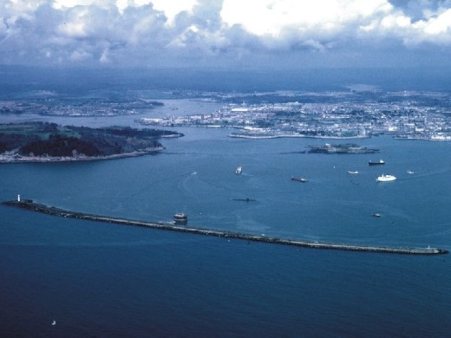
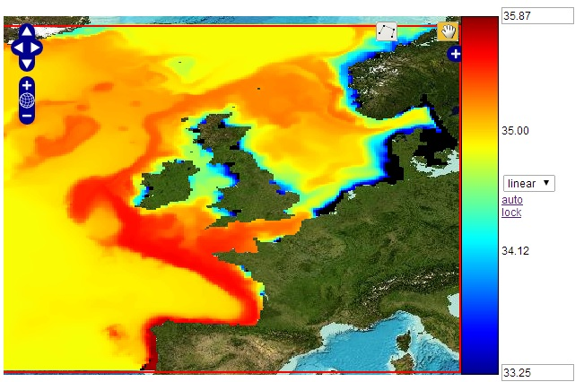
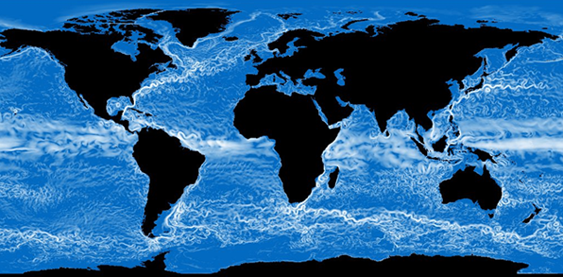
Aquatic modelling needs flexibility: domains
domain
model of choice
scale
resolution
lagoons
unstructured grid models
FVCOM, SCHISM, …
estuaries
shelf seas
coastal ocean models
GETM, ROMS, …
ocean basins
global circulation models
NEMO, MOM, …
world ocean

Slide 4
Aquatic modelling needs flexibility: analysis needs
type of analysis
models
# runs needed
spatial detail
simulation
3D unstructured grids
sensitivity studies
ensembles
3D structured grids
data assimilation
1D water columns
calibration
Markov Chain Monte Carlo
box models
grid parameter space

Slide 5
No one size fits all – abandon tight coupling
Even if the conceptual model looks like this:
light
salinity
PO₄²⁻
phytoplankton
NO₃⁻
temperature
CO₂
O₂
fish
detritus
zooplankton
bacteria
… should the code do so as well?

Slide 6
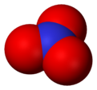
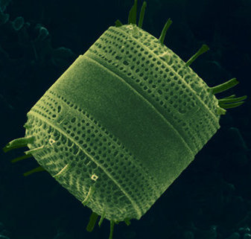
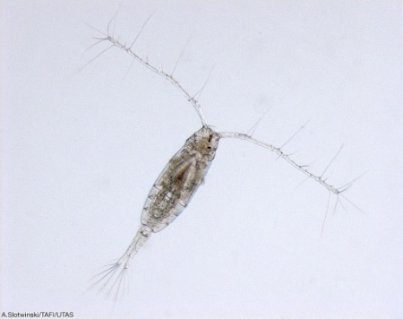
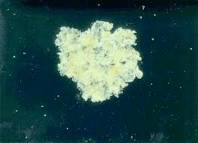
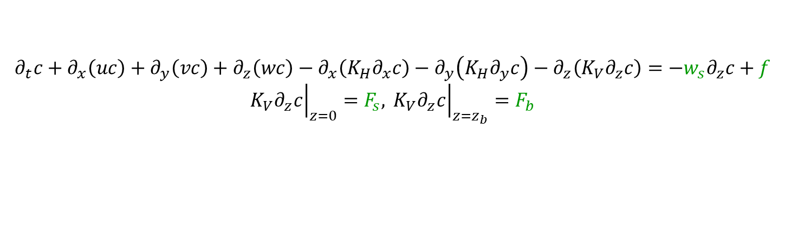
FABM: “separation of concerns”
hydrodynamic model
memory management
advection, diffusion, time integration
input-output
provide physical quantities
temperature
shortwave radiation
salinity
bottom stress
full spatial domain
pressure
wind speed
density
API
FABM
API
API
API
API
all online coupled
biogeochemical models
define own variables and external dependencies (names, units)
request parameter values
given a local environment, provide local source terms, surface/bottom fluxes, vertical velocities
nutrient
phytoplankton
zooplankton
detritus
FABM runs in host with same grid and domain decomposition
local point in space
$$∂_{t}c+∂_{x}\left(uc\right)+∂_{y}\left(vc\right)+∂_{z}\left(wc\right)−∂_{x}\left(K_{H}∂_{x}c\right)−∂_{y}\left(K_{H}∂_{y}c\right)−∂_{z}\left(K_{V}∂_{z}c\right)=−w_{s}∂_{z}c+f$$
$${\left.{K_{V}∂}_{z}c\right|}_{z=0}=F_{s}, {\left.{ K_{V}∂}_{z}c\right|}_{z=z_{b}}=F_{b}$$

Slide 7
About FABM
Developed since 2009 (EU FP7 project “MEECE”)
Aims:
portability: share one biogeochemical code between different hydrodynamic models (0D, 1D, 2D, 3D)
modularity: stand-alone, process-specific biogeochemical modules, combined to create the ecosystem – at run time
One library, runs in host with same grid and domain decomposition
No coupling across grids or time steps
No domain decomposition and parallelization
Thus, FABM does not overlap or compete with MCT, OASIS, ESMF
Fortran 2003 (Intel, gfortran, Cray, PGI, AMD)
Code + extensive documentation: https://fabm.net
Published
Bruggeman & Bolding (2014) A general framework for aquatic biogeochemical models. Environmental Modelling & Software 61, 249–265. 10.1016/j.envsoft.2014.04.002

Slide 8
Development, licensing, copyright
FABM framework
Developed by Bolding & Bruggeman
Continuous development and maintenance (long-term BB strategic investment)
Feature/coupler development funded by dedicated projects
License: GNU General Public License (GPL)
Biogeochemical models
Distributed with FABM or hosted externally (e.g. ERSEM)
Developed and maintained by third parties
License: GPL or more permissive (FreeBSD, LGPL, MIT, CeCILL)
Couplers for physical models
Distributed with physical model
Developed and maintained by third parties
License: GPL or more permissive (FreeBSD, LGPL, MIT, CeCILL)

Slide 9
FABM today: distributed development
hydrodynamics
FABM
biogeochemistry
0D
box model
ERSEM
GOTM
BFM
1D
GLM
ECOSMO
BROM-tp
PISCES
ERGOM
NEMO
MEDUSA
ecosystem
models
ROMS
BSEM
HAMSOM
MAECS
GETM
SELMA
3D
MOM
AED
HYCOM
BROM-bio
FVCOM
PCLake
FESOM-C
spectral irradiance
SCHISM
suspended sediment
ESMF
ShellSIM
process
models
Python
C
DEB
scripts
MATLAB
mizer (fish)
R
seagrass

Slide 10







































FABM today: distributed development
FABM is a core component of:
Copernicus Marine Service: North-West European Shelf (NEMO + ERSEM) & Arctic (HYCOM + ECOSMO)
EU Joint Research Centre policy evaluation suite (GETM + ERSEM/ERGOM/BSEM)
Additional CMEMS biogeochemical models (BFM, PISCES) implemented in H2020 SEAMLESS

Slide 11
Distributed development: where is the code?
external hydrodynamic couplers
Distributed as part of physical model, or as fork
NEMO
FVCOM
SCHISM
ROMS
FESOM
…
On GitHub
open source: GPL v2
FABM
framework
updated by owner via Pull Requests
third-party BGC models
(src/models)
external BGC models
Combined at compile time
No changes to FABM needed
ERSEM
Often on GitHub
Almost always open source
Updated as needed by owners
PISCES
BFM
ShellSIM
spectral light
…

Slide 12
What does FABM actually do? 1. Define communication between physics and BGC
FABM
get_parameter
register_state_variable
register_diagnostic_variable
register_dependency
add_to_aggregate_variable
BGC
initialize
do
do_bottom
do_surface
get_vertical_movement
get_light
It’s a contract
designed to remain stable
backward compatibility is preserved when possible

Slide 13
What does FABM actually do? 2. Call ordering based on dependencies
zenith angle [surface]
light [column]
phytoplankton [interior]
light absorption [interior]
(but reality is more complex – ERSEM has 100s of interlinked calls)

Slide 14
What does FABM actually do? 3. Pack/unpack data
Host
3D + mask
FABM
biogeochemical models
1D, no mask
API call
selected region
var1
cache
read
pack data
var1
var2
var2
var3
all
operations
var3
API result
write
out1
unpack data
out1
out2
out2
out3
out3
out4
out4
out5
out5

Slide 15
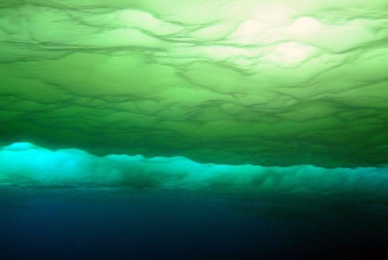
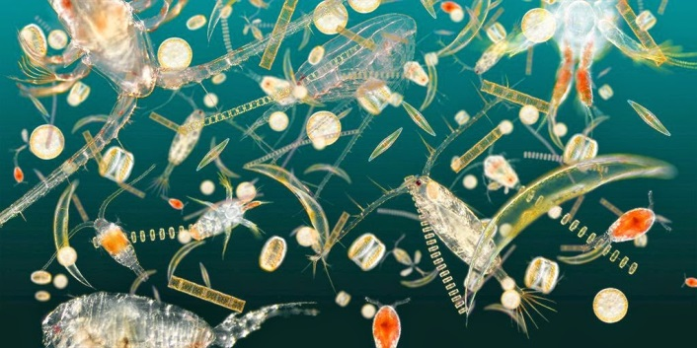
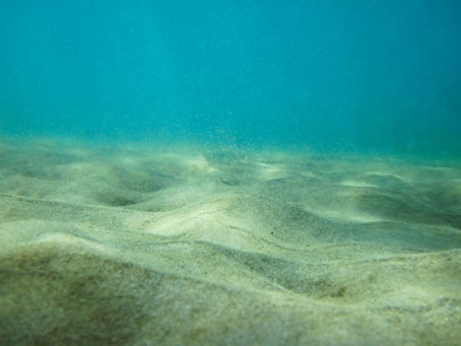
Design: conceptual domain
surface
state (# m⁻²)
ice algae
atmosphere
diagnostics
air-sea flux of CO₂
interior
state (# m⁻³)
nutrients
plankton
suspended sediment
diagnostics
primary production
pH
photosynthetically active radiation
state (# m⁻²)
bed sediment
benthic fauna
pore water nutrients
diagnostics
erosion flux
bottom

Slide 16
Design: conceptual domain
surface
API: do_surface
sources of surface state variables (# m⁻² s⁻¹)
surface flux of interior state variables (# m⁻² s⁻¹)
surface diagnostics
interior
API: do
sources of interior state variables (# m⁻³ s⁻¹)
interior diagnostics
API: get_vertical_movement
residual vertical velocity of interior state variables (m s⁻¹)
API: do_bottom
sources of bottom state variables (# m⁻² s⁻¹)
bottom flux of interior state variables (# m⁻² s⁻¹)
bottom diagnostics
bottom

Slide 17
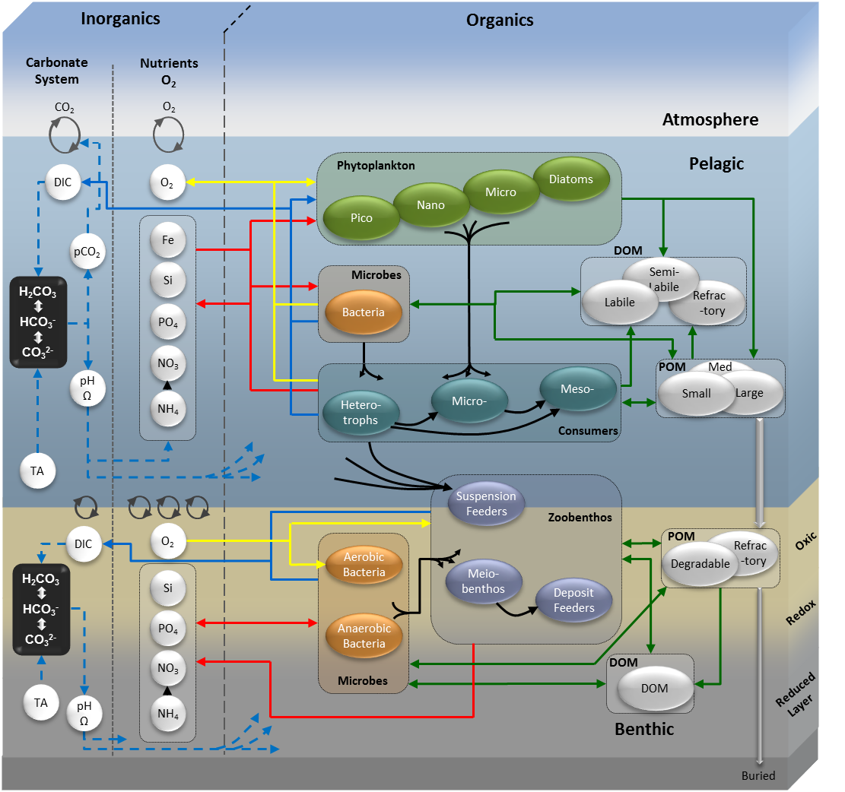
ERSEM: an example of modular modelling
Inception: early 1990s
Applications
carbon and nutrient budgets
projecting ecosystem change
fish, fisheries & aquaculture
biodiversity
carbon capture and storage
ocean acidification
invasive species/harmful algae
habitat definition
>200 peer-reviewed papers
PML: 18 people developing
biogeochemical processes
ecosystem structure
programming infrastructure
Butenschön et al 2015 GMD

Slide 18
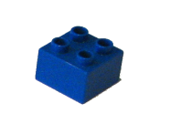
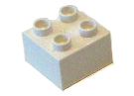
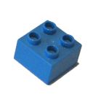
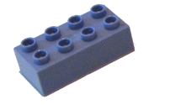
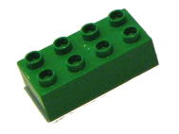
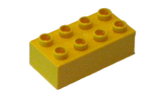
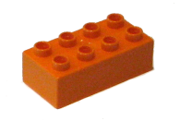

ERSEM: an example of modular modelling
ERSEM =
6 x
passive particle
options: sinking and remineralisation
1 x
calcium carbonate
dissolution dependent on saturation state
1 x
oxygen
exchange with atmosphere over water surface
1 x
carbonate system
exchange with atmosphere over water surface, pH
4 x
primary producer
options: silicate use, calcification
1 x
predator with fixed stoichiometry
user-specified selection of prey
2 x
predator with variable stoichiometry
user-specified selection of prey, overwintering behaviour
1 x
bacteria
user-specified selection of substrates

Slide 19
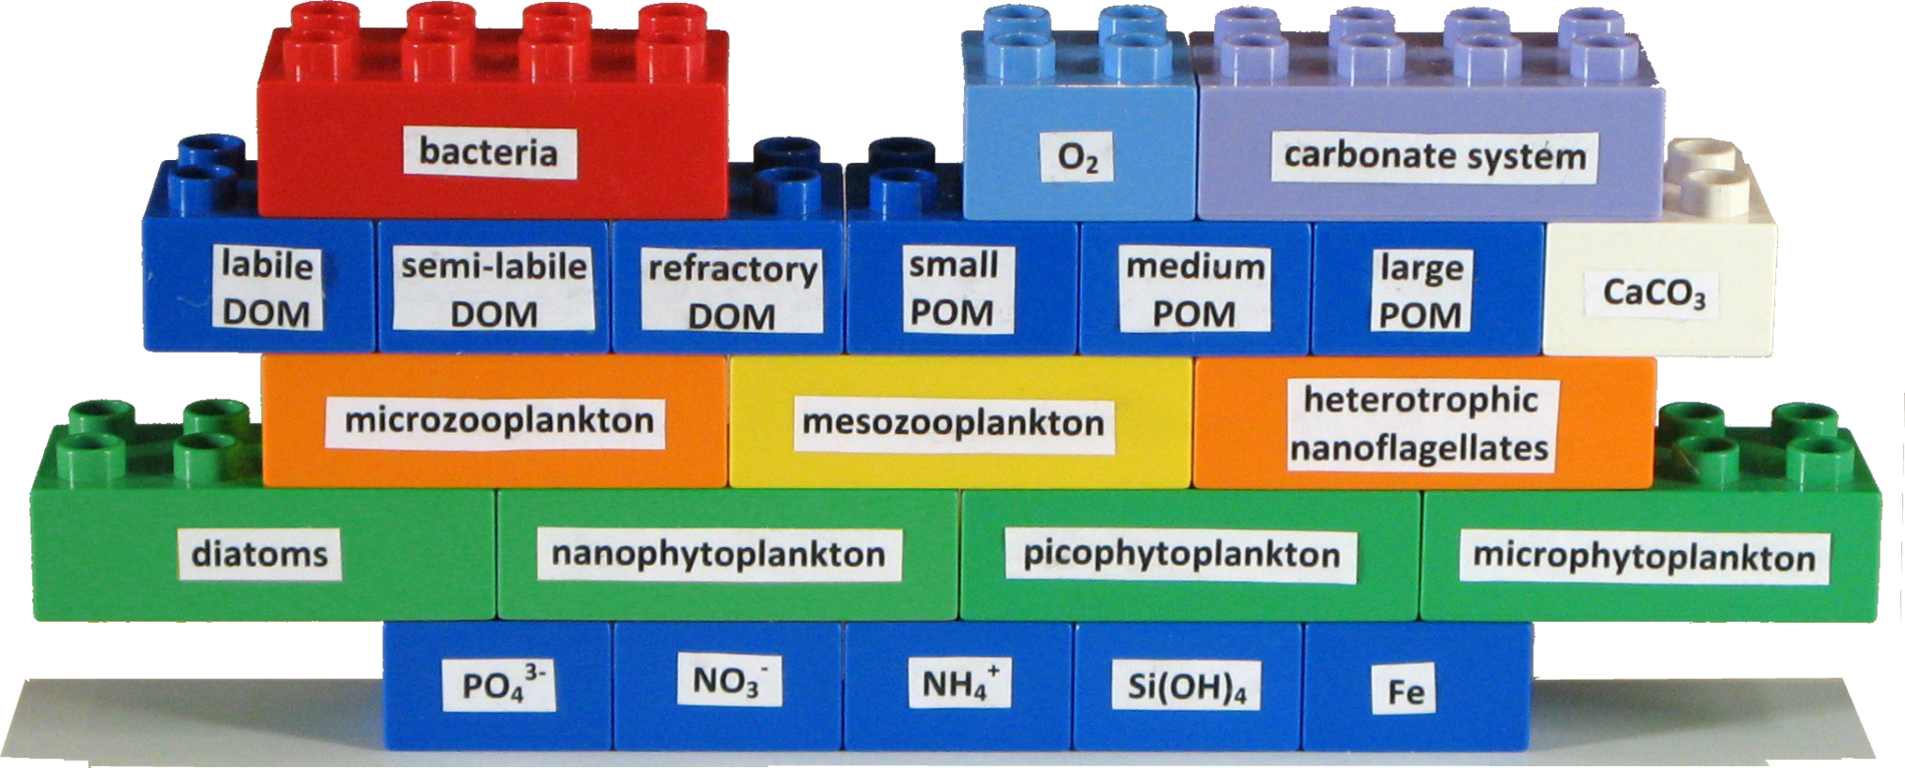
ERSEM: an example of modular modelling
Each module can appear any number of times
Mix-and-match: any model component can be replaced by observed data
What makes it unique?
Configure everything by editing one text file – no code, programming, compilation
The same configuration and code everywhere: 0D, 1D (ERSEM workshops), 3D

Slide 20
Coupling: combining stand-alone modules
mesozooplankton
phosphate
diatoms
prey 1
prey 1
P
phosphate
prey 1
C
C
C
medium POM
N
N
detritus
P
P
C
C
N
N
Si
Si
P
P
Fe
Fe
Si
Si
Chl
Fe
Fe
hydrodynamic model
temperature
temperature
temperature
salinity

Slide 21
Modular ERSEM – benefits
Tailor model complexity to application
Reduce complexity where required: computational cost of high-resolution hydrodynamics does not allow many (>25) biogeochemical state variables in Earth System Models
Increase complexity where needed: questions on biodiversity, invasive species demand the capability to freely add/remove groups
Tailor feature set to application
Different questions, different features: carbonate system, redox chemistry, size-structured higher trophic levels, fisheries, seagrass
Flexible currencies: biogeochemical cycles need C, N, P, Si, Fe; end-to-end food webs need abundance and size
Collaborate
Import: redox chemistry, size-structured fish community
Export: carbonate system

Slide 22
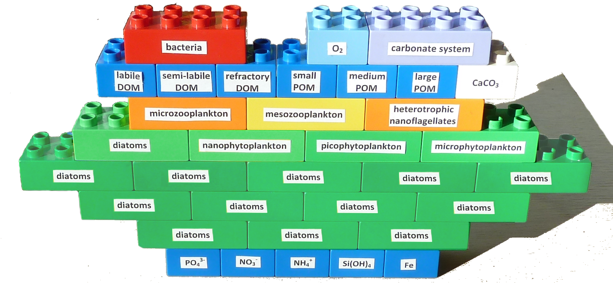
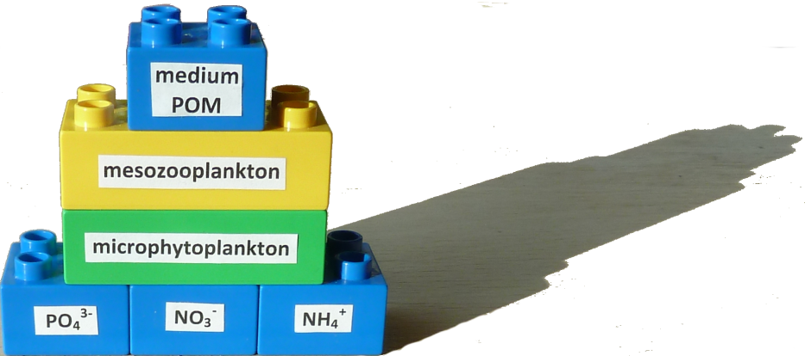
Modular ERSEM – what have we gained?

Slide 23
A wealth of component models
plankton
Note: FABM makes coupling between biogeochemical component models easier, but that does not mean everything is “plug and play”
Compatibility between component models often requires that they use a similar level of detail – e.g., they describe the same elemental cycles
ERSEM
MEDUSA
higher trophic levels
fish - MIZER
bivalves - ShellSIM
Dynamic Energy Budgets
seagrass
carbonate chemistry
spectral light
sediments

Slide 24
FABM: a biogeochemical modeller’s perspective
Enable distributed development
different people/institutes writing process-specific modules that remain compatible
mix in 3rd party modules: ERSEM carbonate chemistry, benthic fauna, NIVA redox chemistry
Code once, run anywhere
test in 0D (scripting languages!) and 1D before 3D simulation
share modules across domains: use the same microbial processes and chemistry in ice, water, sediment
Stay flexible with “lego brick biogeochemistry”
allow questions and constraints to dictate final ecosystem complexity

Slide 25
FABM: a user’s perspective
fabm.yaml
nutrient
phytoplankton
instances:
nutrient:
model: examples/npzd/nut
initialization:
c: 1.0
phytoplankton:
model: examples/npzd/phy
initialization:
c: 0.001
coupling:
nutrient_source: nutrient/c
excretion_sink: nutrient/c
mortality_sink: detritus/c
zooplankton:
model: examples/npzd/zoo
initialization:
c: 0.001
coupling:
prey_source: phytoplankton/c
excretion_sink: nutrient/c
mortality_sink: detritus/c
detritus:
model: examples/npzd/det
initialization:
c: 0.0
coupling:
mineralization_sink: nutrient/c
nutrient
concentration
excretion sink
mortality sink
concentration
detritus
zooplankton
prey
mineralization sink
excretion sink
concentration
mortality sink
concentration

Slide 26
FABM: a user’s perspective
Run-time configurability
Specify ecosystem structure at run-time; no programming, preprocessing or compilation needed
Why?
Empower end users: give maximum control, but shield from programming mistakes
How?
Single configuration file in YAML format (http://yaml.org)
Cost?
Negligible: work >> overhead of run time coupling and communication
fabm.yaml
instances:
nutrient:
model: examples/npzd/nut
initialization:
c: 1.0
phytoplankton:
model: examples/npzd/phy
initialization:
c: 0.001
coupling:
nutrient_source: nutrient/c
excretion_sink: nutrient/c
mortality_sink: detritus/c
zooplankton:
model: examples/npzd/zoo
initialization:
c: 0.001
coupling:
prey_source: phytoplankton/c
excretion_sink: nutrient/c
mortality_sink: detritus/c
detritus:
model: examples/npzd/det
initialization:
c: 0.0
coupling:
mineralization_sink: nutrient/c

Slide 27
FABM: a physical modeller’s perspective
Access a vast biogeochemical library by coupling once
enumerate state variables, diagnostic variables, conserved quantities
access source/sink terms, boundary fluxes, vertical movement, …
Seamless integration: FABM adapts to host by taking
number of dimensions (0-3)
index of vertical dimension
index of dimension to vectorize
mask data type, masked value, mask domain (full or hz-only)
and defines its interfaces as a result:
Compiled as a library, no dependencies
0D:
1D:
3D:
fabm_do()
fabm_do(kstart,kstop)
fabm_do(istart,istop,j,k)
fabm_do_surface()
fabm_do_surface()
fabm_do_surface(istart,istop,j)

Slide 28
Performance example (FVCOM)
BGC
FABM
 | pelagic state variables | benthic state variables
passive | 1 | 0
Fasham | 7 | 0
ERGOM | 10 | 2
ERSEM | 50 | 36
Profiling: Intel Fortran compiler 14.0, LIMITED_2;GCY1;MPDATA;FABM;WET_DRY;MULTIPROCESSOR;PROJ, serial run

Slide 30
Component models - ERSEM
plankton
ERSEM
MEDUSA
higher trophic levels
fish - MIZER
bivalves - ShellSIM
Dynamic Energy Budgets
seagrass
carbonate chemistry
spectral light
ingredient X
Butenschön et al. 2016 GMD

Slide 31

Component models - ERSEM
plankton
ERSEM: a showcase for modular ecosystem modelling
ERSEM
MEDUSA
higher trophic levels
fish - MIZER
bivalves - ShellSIM
Dynamic Energy Budgets
Each module can appear any number of times
Mix-and-match: any model component can be replaced by observed data
What makes it unique?
Configure everything by editing one text file – no code, programming, compilation
The same configuration and code everywhere: 0D, 1D, 3D
seagrass
carbonate chemistry
spectral light
ingredient X
Butenschön et al. 2016 GMD

Slide 32
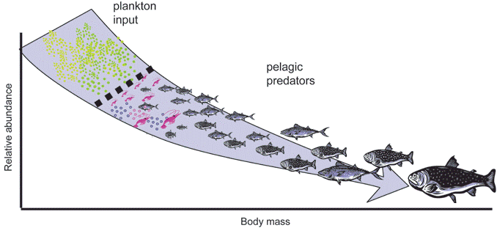
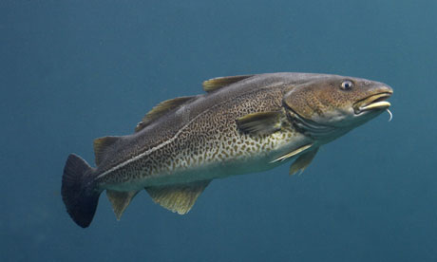
Component models - fish
plankton
ERSEM
MEDUSA
higher trophic levels
fish - MIZER
bivalves - ShellSIM
Model:
size-based (1 mg – 100 kg, 100 classes)
pelagic feeding only
depth-integrated
different fisheries parameterizations
Dynamic Energy Budgets
seagrass
carbonate chemistry
Applications:
fish stocks/fisheries
aquaculture
improving top closure
spectral light
sediments
Blanchard et al. 2014 J Appl Ecol

Slide 33
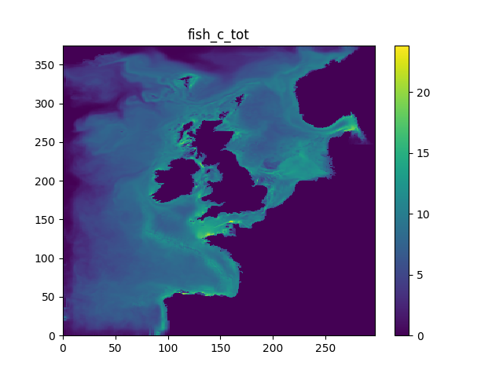
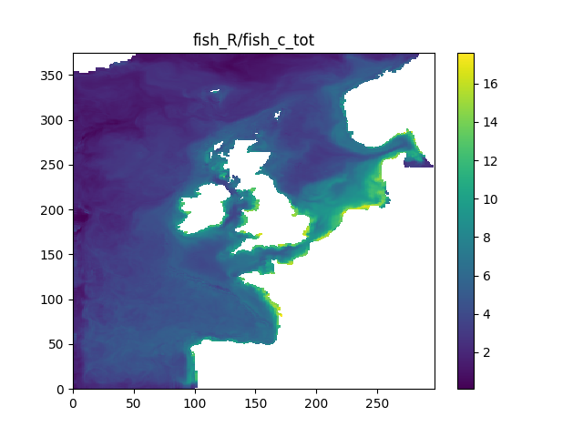

Component models - fish
plankton
fish biomass
ERSEM
MEDUSA
g WM/m²/d
higher trophic levels
fish - MIZER
bivalves - ShellSIM
Dynamic Energy Budgets
fish reproduction
seagrass
carbonate chemistry
#/g WM
spectral light
sediments
Helen Powley
hpo@pml.ac.uk
Powley et al. in prep

Slide 34
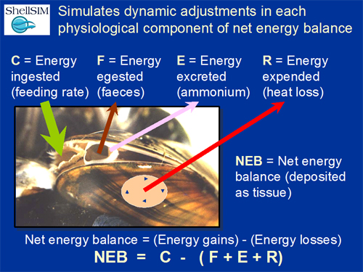
Component models - ShellSIM
plankton
ERSEM
MEDUSA
higher trophic levels
fish - MIZER
bivalves - ShellSIM
Dynamic Energy Budgets
seagrass
carbonate chemistry
spectral light
ingredient X
Hawkins et al. 2013 J Shellfish Res

Slide 35
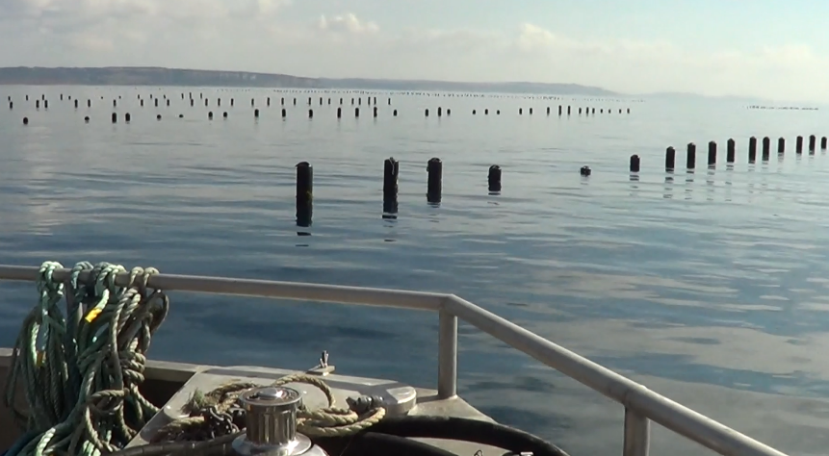
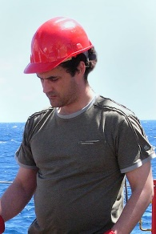
Application – mussel farms
plankton
ERSEM
MEDUSA
higher trophic levels
fish - MIZER
bivalves - ShellSIM
Rope-cultured blue mussels, Lyme Bay, Devon, UK
Expanding: 3 sites, > 10,000 ton/year
environmental impacts
HABs
river pathogens
food web resources
Modelling: FVCOM + ERSEM + ShellSIM
Dynamic Energy Budgets
seagrass
carbonate chemistry
spectral light
ingredient X
Ricardo Torres
rito@pml.ac.uk

Slide 36
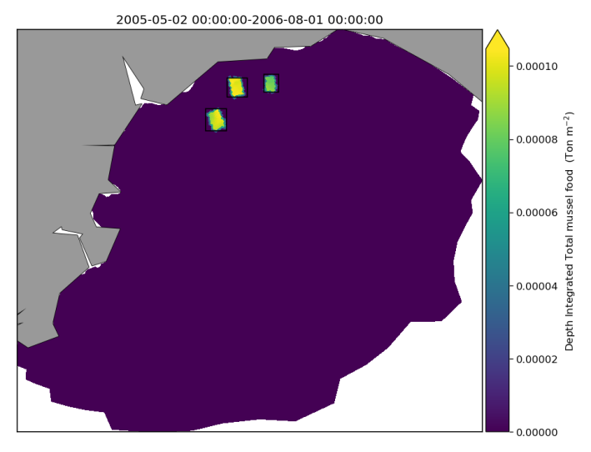
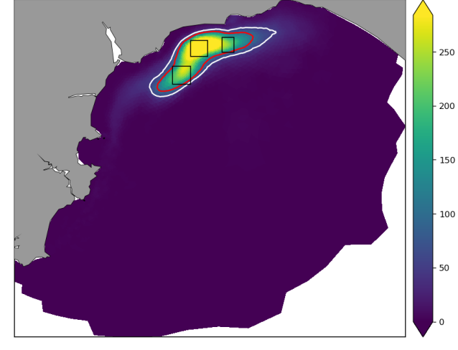
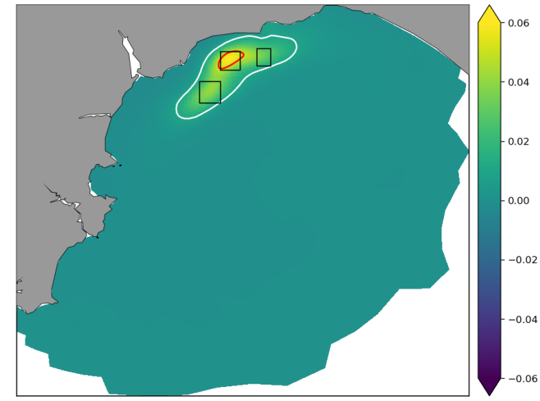
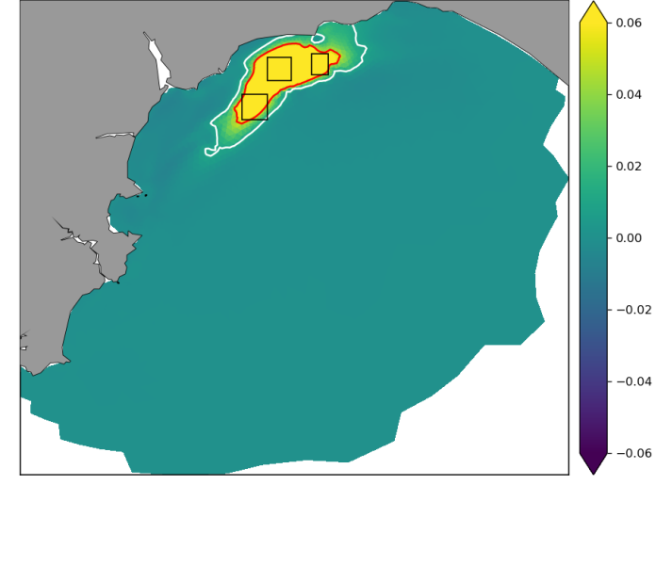
Application – mussel farms
plankton
mussel production
increased POC flux at bed
ERSEM
MEDUSA
higher trophic levels
fish - MIZER
bivalves - ShellSIM
increase in benthic fauna
decrease in pore water oxygen
Dynamic Energy Budgets
seagrass
carbonate chemistry
spectral light
ingredient X
Ricardo Torres
rito@pml.ac.uk

Slide 37
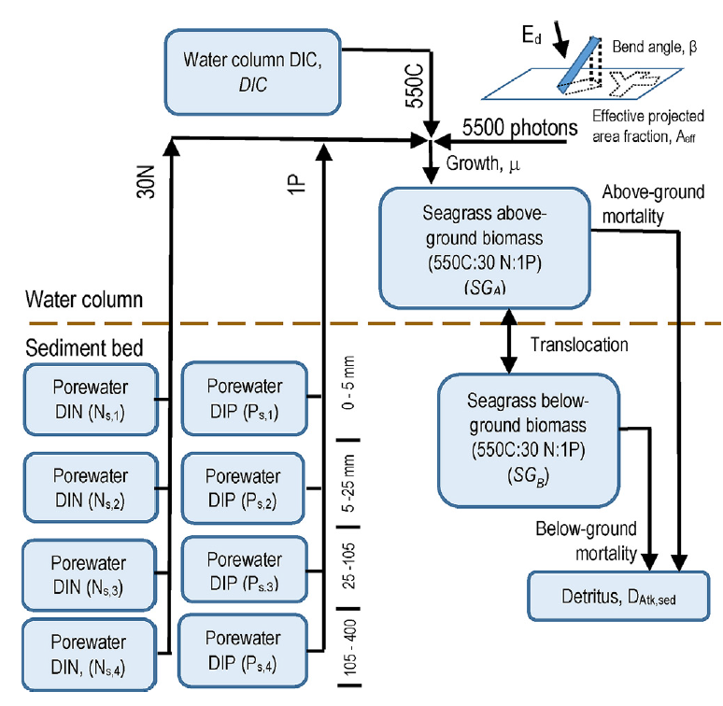
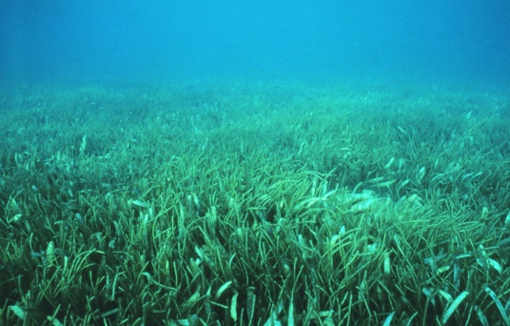
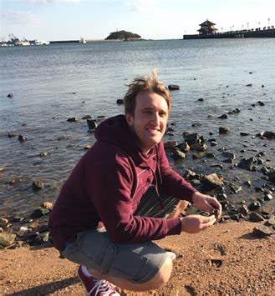

Component models - seagrass
plankton
ERSEM
MEDUSA
higher trophic levels
fish - MIZER
bivalves - ShellSIM
Dynamic Energy Budgets
seagrass
carbonate chemistry
Applications:
coastal carbon budgets
erosion/coastal defence
eutrophication indicators
spectral light
ingredient X
Matthew Adams
m.adams5@uq.edu.au
Baird et al 2016 Ecol Mod

Slide 38
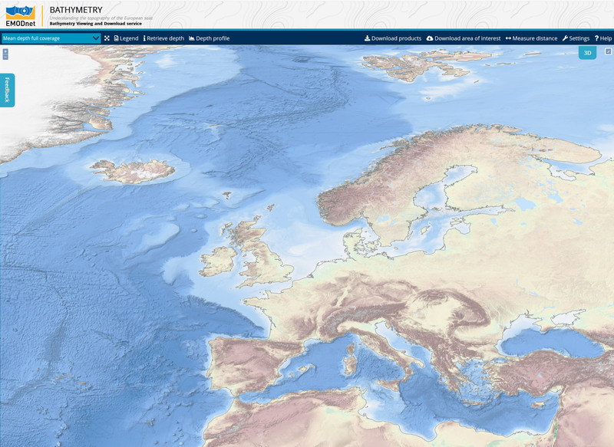
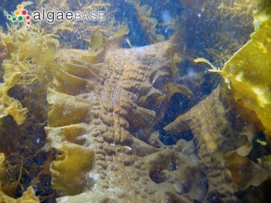
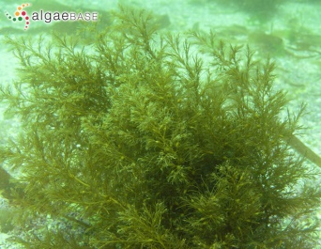
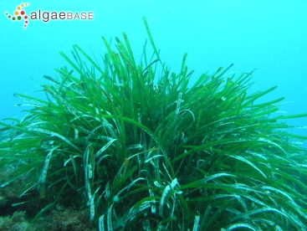

Application – seaweed/seagrass distribution changes
plankton
ERSEM
MEDUSA
Zostera
higher trophic levels
fish - MIZER
bivalves - ShellSIM
Saccharina
Laminaria
Dynamic Energy Budgets
seagrass
carbonate chemistry
spectral light
Cystoseira
ingredient X
Posidonia

Slide 39

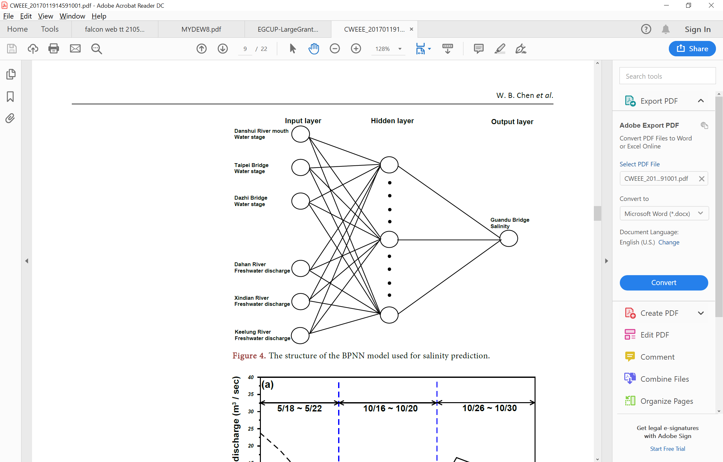
Application – seaweed/seagrass distribution changes
plankton
ERSEM
MEDUSA
process-based model in Python-FABM
Start: seagrass model (Baird et al. 2016)
To be generalized to seaweeds (e.g., allow nutrient uptake by above-ground biomass)
machine learning
Start: artificial neural networks [Python] used previously to predict e.g. river flow/concentration
higher trophic levels
fish - MIZER
potential
biomass
bivalves - ShellSIM
annual mean
production
Dynamic Energy Budgets
annual mean
respiration
biomass
seagrass
wave
exposure
carbonate chemistry
salinity
temperature response, light capture, nutrient uptake
…
spectral light
ingredient X

Slide 40
Component models – spectrally resolved irradiance
plankton
ERSEM
upper atmosphere
absorption by water vapour, ozone, oxygen, carbon dioxide
MEDUSA
lower atmosphere
scattering and absorption – Rayleigh, aerosols, clouds
higher trophic levels
fish - MIZER
ocean surface
reflection & refraction
bivalves - ShellSIM
3D ocean interior – for every single layer
absorption & scattering by Inherent Optical Properties
Dynamic Energy Budgets
detritus
dissolved organics
total absorption: a(λ)
heating
seagrass
phytoplankton
total scattering: b(λ)
seawater
carbonate chemistry
underwater PAR
photosynthesis
spectral light
Applications:
photodegradation (UV)
assimilation of satellite data (water leaving irradiance)
sediments
Gregg & Rousseaux 2016 Front Mar Sci

Slide 41
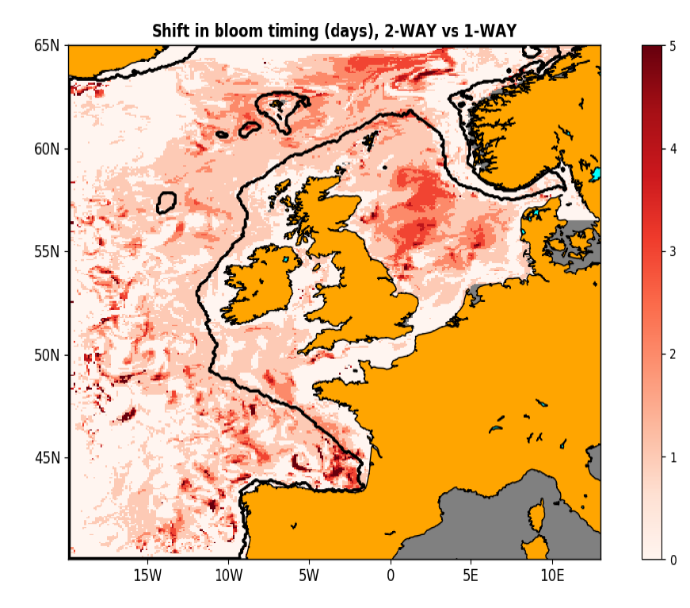
Component models – spectrally resolved irradiance
plankton
Feedback from light (FABM) to NEMO temperature improves bloom timing:
ERSEM
MEDUSA
higher trophic levels
fish - MIZER
bivalves - ShellSIM
Dynamic Energy Budgets
seagrass
carbonate chemistry
spectral light
sediments
Jozef Skákala
jos@pml.ac.uk
Gregg & Rousseaux 2016 Front Mar Sci

Slide 42
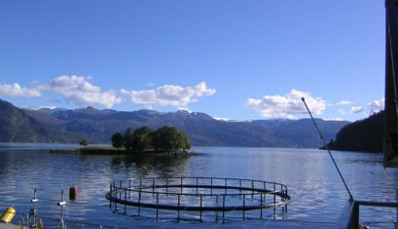
Application – sea lice treatment in fish farms
plankton
ERSEM
MEDUSA
higher trophic levels
fish - MIZER
bivalves - ShellSIM
Salmon farms, Hardangerfjord & Øygarden, Norway
Sea lice treatments in fish cages are potentially harmful to pelagic and benthic ecosystems
Environmental impact assessments track the fate of treatment agents. But these are transported in non-standard ways!
Some adsorb to particulate organics [fish waste]
Some affect water density (feedback to physics)
Dynamic Energy Budgets
seagrass
carbonate chemistry
spectral light
ingredient X

Slide 43
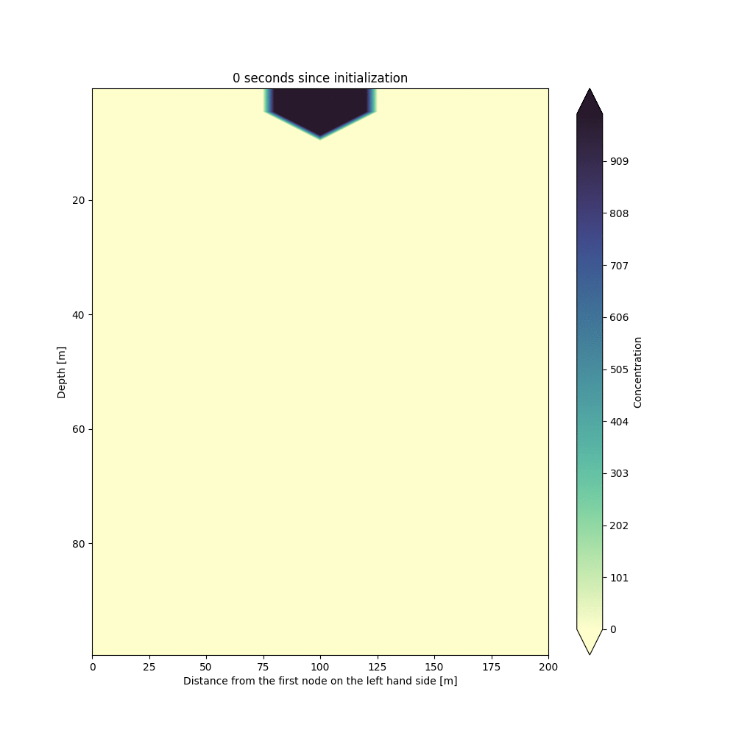

Application – sea lice treatment in fish farms
plankton
ERSEM
MEDUSA
higher trophic levels
fish - MIZER
bivalves - ShellSIM
Dynamic Energy Budgets
seagrass
Hydrogen peroxide is denser than water, and the mixture used for de-licing will be ~2 ‰ denser than surrounding water. In a homogeneous water column it will sink to 100 m in ~ 7 - 8 minutes.
The simulation of a sinking plume of hydrogen peroxide shown here is created with non-hydrostatic FVCOM.
carbonate chemistry
spectral light
ingredient X
Ole Anders Nøst
ole.anders.nost@akvaplan.niva.no

Slide 44
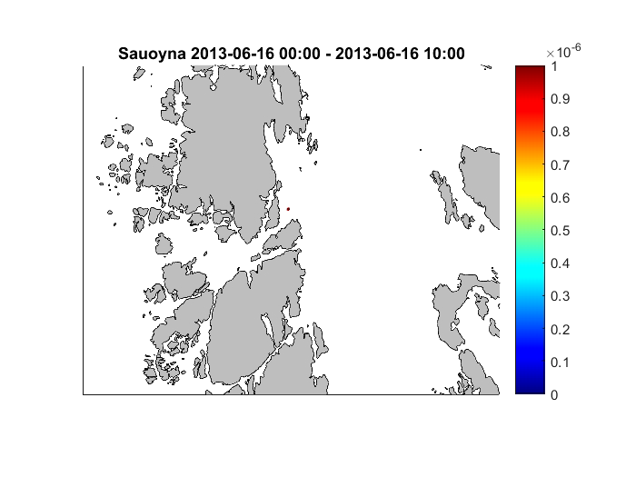
Application – sea lice treatment in fish farms
plankton
ERSEM
MEDUSA
higher trophic levels
fish - MIZER
bivalves - ShellSIM
Dynamic Energy Budgets
seagrass
Simulation of a single release from Sauøyna
carbonate chemistry
spectral light
ingredient X
Ole Anders Nøst
ole.anders.nost@akvaplan.niva.no

